Slide 1



Salary Prediction Using Linear Regression
Name: Bishal Saha
Machine Learning Project | Data Science Course

Slide 2






Introduction to Salary Prediction
Salary prediction uses machine learning to estimate compensation based on employee characteristics and market factors. This analytical approach transforms how organizations approach compensation strategy.
Hiring Strategy
By analyzing patterns in historical salary data, predictive models help companies make data-driven decisions about fair compensation, budget allocation, and competitive positioning in the talent market.
Competitive offer optimization
Budget Planning
Accurate financial forecasting
Market Analysis
Industry benchmark insights

Slide 3

Project Objective
Primary Goal
Develop a predictive model that accurately estimates employee salary by analyzing key professional attributes and job characteristics.
Key Features
Years of experience, education level, job role, industry sector, and geographical location serve as primary predictors.
Expected Outcome
A reliable regression model that helps organizations make informed compensation decisions with statistical confidence.

Slide 4
Dataset Description
Data Source & Structure
Key Features
The dataset comprises employment records from multiple organizations, containing comprehensive salary and employee attribute information.
Experience: Years of professional work (0-40 years)
Education: Bachelor's, Master's, PhD levels
Job Role: Position title and responsibility level
Location: Geographic region and cost of living
5000
12
Industry: Technology, finance, healthcare sectors
Company Size: Small, medium, large organizations
Total Records
Features
Employee observations
Predictor variables
1
Target Variable
Annual salary

Slide 5
Data Preprocessing Pipeline
Transforming raw data into model-ready format requires systematic cleaning and feature engineering to ensure prediction accuracy.
01
02
Missing Value Treatment
Categorical Encoding
Identified null values in experience and education columns; applied median imputation for numerical fields and mode for categorical variables.
Converted job roles, education levels, and locations into numerical format using one-hot encoding and label encoding techniques.
03
04
Feature Scaling
Outlier Detection
Applied StandardScaler to normalize numerical features, ensuring all variables contribute equally to model training.
Removed extreme salary outliers using IQR method to prevent skewed predictions and improve model generalization.

Slide 6
Linear Regression Model
Understanding the Algorithm
Why Linear Regression?
Linear regression models the relationship between dependent and independent variables by fitting a linear equation to observed data. The model minimizes the sum of squared residuals to find the best-fit line.
Interpretable results with clear coefficient meanings
Fast training and prediction speed
Strong baseline for salary estimation
Mathematical Foundation:
Effective for continuous target variables
Where y represents predicted salary, \beta values are coefficients, x variables are features, and \epsilon is the error term.

Slide 7





Implementation Steps
Data Loading & Exploration
Import dataset using Pandas, perform exploratory analysis, visualize distributions and correlations between features and target variable.
Feature Engineering
Create derived features, handle categorical variables with encoding, and scale numerical features using StandardScaler from Scikit-learn.
Train-Test Split
Divide dataset into 80% training and 20% testing sets using stratified sampling to maintain data distribution across splits.
Model Training
Initialize LinearRegression model, fit to training data, optimize coefficients using ordinary least squares method for best performance.
Prediction & Evaluation
Generate predictions on test set, calculate performance metrics, and validate model assumptions through residual analysis.

Slide 8

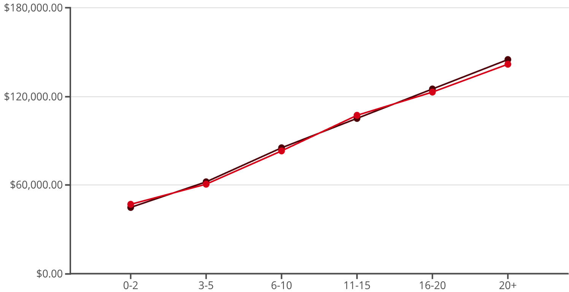

Results & Evaluation Metrics
The trained model demonstrates strong predictive performance across multiple evaluation criteria, indicating reliable salary estimation capabilities.
82%
R² Score
Variance explained by model
87%
Actual Salary
Predicted Salary
Accuracy
The model shows strong alignment between actual and predicted salaries across experience levels, with minimal deviation in most ranges.
Overall prediction precision
Additional Metrics:
MAE: $8,450 average error
RMSE: $11,200 root mean squared error
Training Time: 0.03 seconds

Slide 9
Challenges & Solutions
Data Inconsistency
Multicollinearity
Model Underfitting
Challenge: Irregular formats, missing entries, and conflicting salary ranges across sources.
Challenge: High correlation between experience and education levels affecting coefficient stability.
Challenge: Basic linear assumptions failed to capture complex non-linear salary patterns.
Solution: Implemented robust data validation pipeline with automated cleaning scripts and standardized formatting rules.
Solution: Applied VIF analysis to identify redundant features and removed highly correlated predictors to improve model interpretability.
Solution: Engineered polynomial features and interaction terms to capture non-linear relationships while maintaining interpretability.

Slide 10

Conclusion & Future Scope
Key Outcomes
Future Enhancements
The linear regression model successfully predicts employee salaries with 82% accuracy, providing actionable insights for compensation strategy. The model demonstrates reliable performance across different experience levels and job roles.
Advanced Algorithms
Implement Ridge and Lasso regularization to handle multicollinearity and prevent overfitting.
This foundational approach establishes a data-driven framework for salary estimation that can be integrated into HR systems and compensation planning tools.
Ensemble Methods
Explore Random Forest and Gradient Boosting models for capturing complex non-linear patterns.
Feature Expansion
Incorporate additional predictors like skills, certifications, performance ratings, and market demand indicators.
Real-time Updates
Deploy model as API with automated retraining pipeline to adapt to evolving market conditions.

